Slide 3
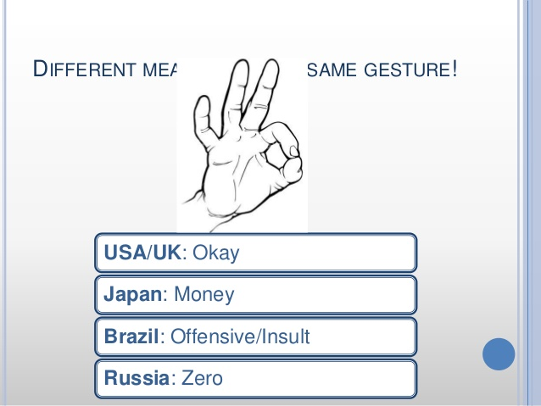

Slide 5
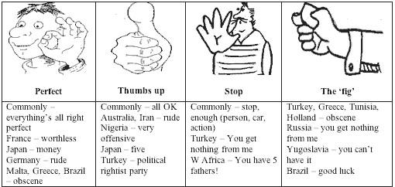

Slide 6
Social Cognition of Communication
Dr. Vinod Bhatt
Associate Professor
School of Social Languages

Slide 7

Social Cognition
Social cognition (SC) serves an interface between psychology and cognitive neuroscience and its conceptualization has evolved over years.
Social cognition broadly refers to a process of encoding and decoding the social information, i.e., how a person thinks about himself/herself and others in his/her social world
At present, major research groups in this field have agreed on that emotion perception, social perception, theory of mind, and attributional style to be the key domains of Social cognition .

Slide 8
Social Cognition
The Communication and Social Cognition Division is dedicated to the study of the social cognitive aspects of message production, reception, and processing.
Relevant topics might include, but are not limited to,
Cognition
Emotion
Social influence
Social perception
Listening
Information processing
Affective processes
Message effects
Brain function
Personality and individual differences in communication.

Slide 9
Why is Social Cognition Important?
Children with poor social cognition show problems in many areas:
More conflict and communication problems
Lower acceptance among peers
Lower social skills
More behaviour problems
Less sophisticated academic skills (e.g. language)

Slide 10
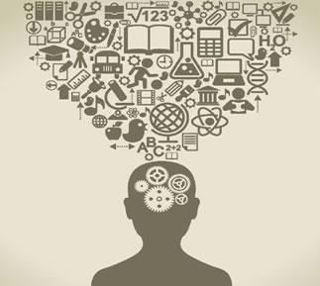

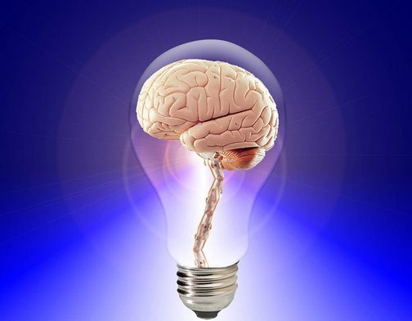
Cognition
Cognition refers to "the mental action or process of acquiring knowledge and understanding through thought, experience, and the senses"

Slide 11

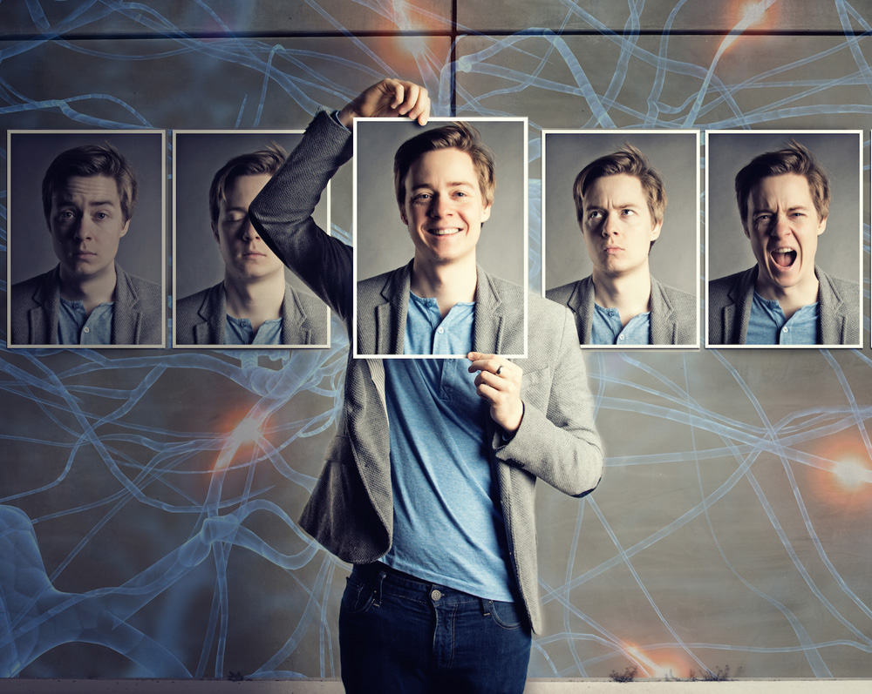
Emotion
At the most general level, emotion modulates and mediates basic cognitive processes

Slide 12


Social influence

Slide 13

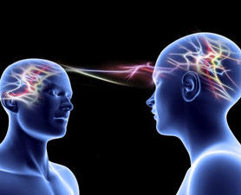
Social perception Social cognition is a broad term used to describe cognitive processes related to the perception, understanding, and implementation of linguistic, auditory, visual, and physical cues that communicate emotional and interpersonal information.

Slide 14


Listening

Slide 15
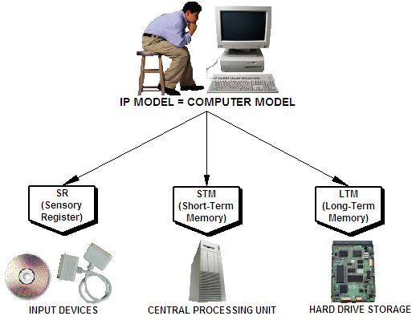
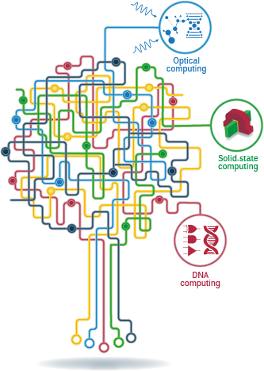
Information processing
The information processing approach characterizes thinking as the environment providing input of data, which is then transformed by our senses.

Slide 16

Affective processes

Slide 17

Message effects

Slide 18
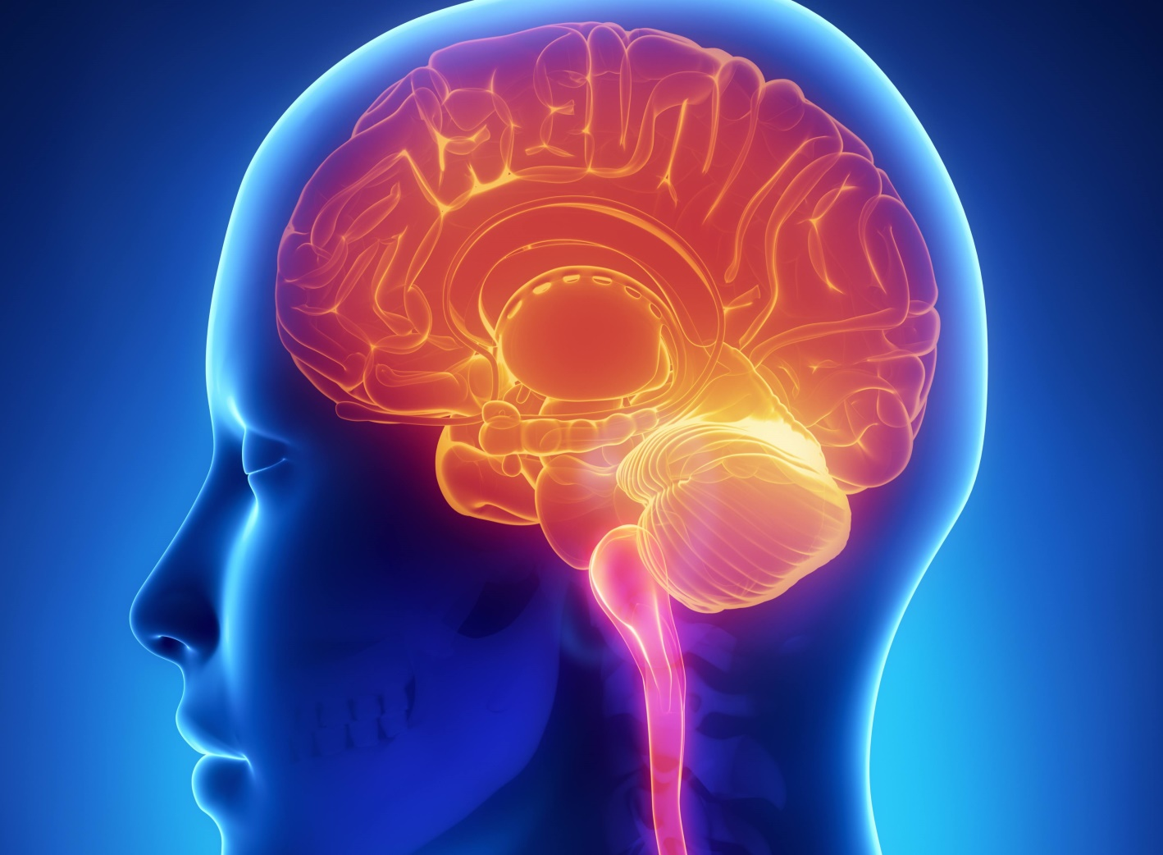
Brain function

Slide 19



Personality and individual differences in communication.

Slide 20


Slide 21
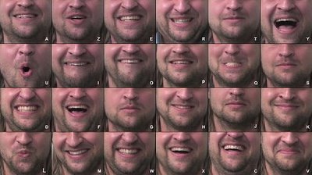

Slide 22
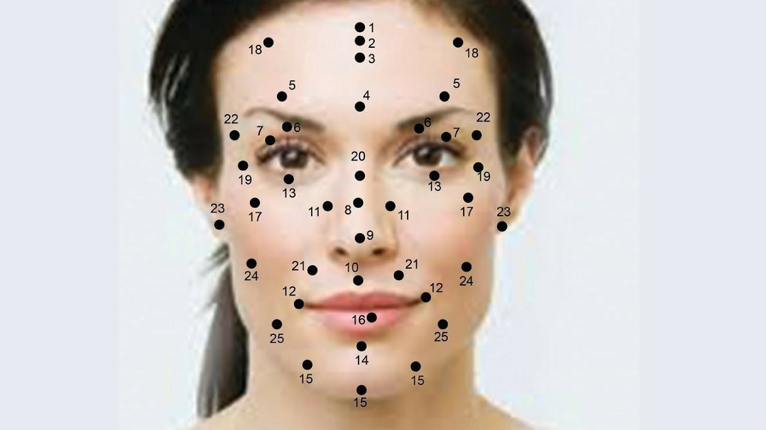

Slide 24


Slide 25

Social Cognition and Gender
Males have much higher level of performance
women are better at recognizing facial effects, expression processing and emotions in general.
Men were only better at recognizing specific behaviour which includes anger, aggression and threatening cues.
Studies have also found males to be slower in making social judgments than females.
Researchers suppose that these sex differences in social cognition predisposes males to high rates of autism spectrum disorders which is characterized by lower social cognition

Slide 26
Social Cognition and Culture
How we develop, particularly how we learn and think is primarily a function of the social and cultural environment in which we are reared.
Consider the differences between children who grow up in a technologically driven society and children who grow up in a hunter-gatherer type of society in Africa…

Slide 27
Social Cognition and Gender
Gender differences in educational attainment may contribute to disparities in cognitive functioning in developing settings.
Women in developing countries typically lack equal access to education
Traditional gender roles and inequitable investments in the human capital of sons and daughters have caused a substantial gender gap in educational attainment.

Slide 28
Social Cognition and Culture
Culture is transmitted to children by their parents and other members of society.
Children’s intellectual processes are developed to handle tasks and problems important to the particular surroundings.

Slide 29
There are three core concepts at the heart of social learning theory
First is the idea that people can learn through observation.
Next is the idea that internal mental states are an essential part of this process. Meaning that the ability to form memories from what you observe are key to learning.
Finally, this theory recognizes that just because something has been learned, it does not mean that it will result in a change in behavior.

Slide 37
Thanks

